Slide 1

HPML Group 11/01/2023
Deep Learning
CNNs
Bryan Cardenas
Thomas van Osch

Slide 2
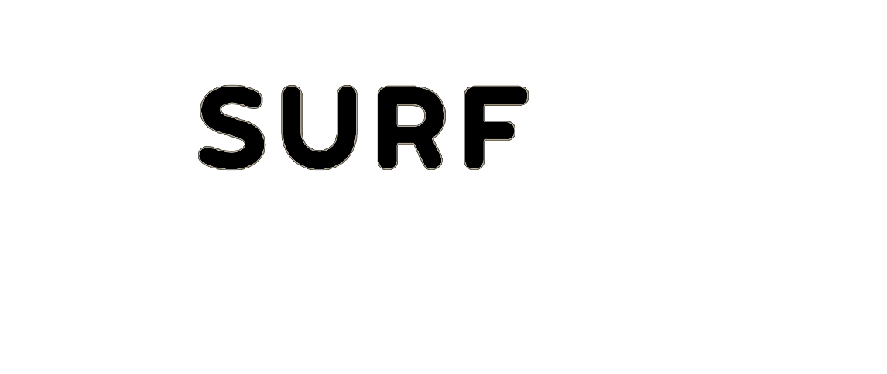
How do Computers see?

Slide 3
How do Humans see?

Slide 4
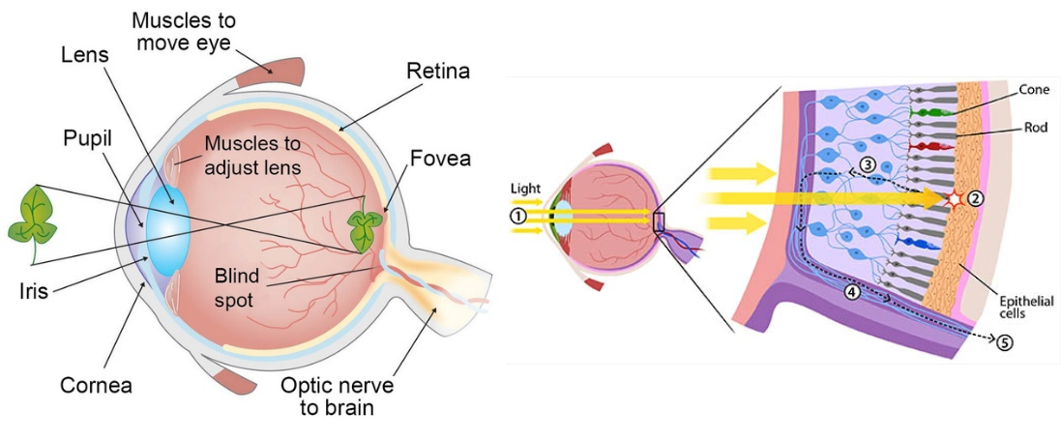
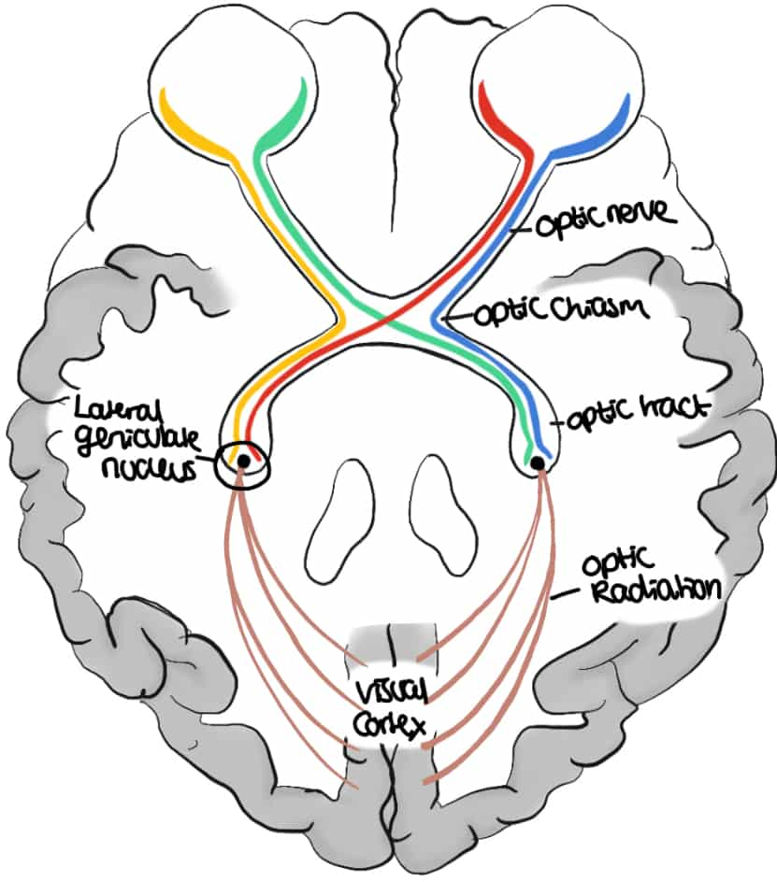
Mammalian Visual System

Slide 5
Mammalian Visual System
Cones and rods picks up photons and propagate the signal to the back of our brain
Along the way, the signal gets processed in stages

Slide 6
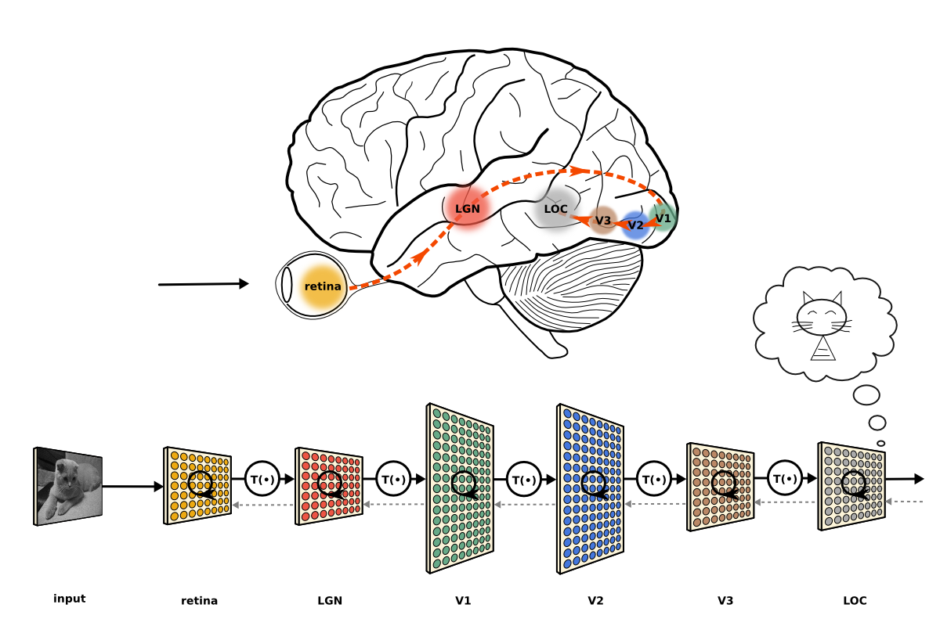
Mammalian Visual System
Cones and rods picks up photons and propagate the signal to the back of our brain
Along the way, the signal gets processed in stages
The extracted information gets aggregated and formed into an image

Slide 7
Mammalian Visual System
Cones and rods picks up photons and propagate the signal to the back of our brain
Along the way, the signal gets processed in stages
The extracted information gets aggregated and formed into an image

Slide 8
11/01/2023
Convolutional
Neural Networks
High Performance Machine Learning Group

Slide 9
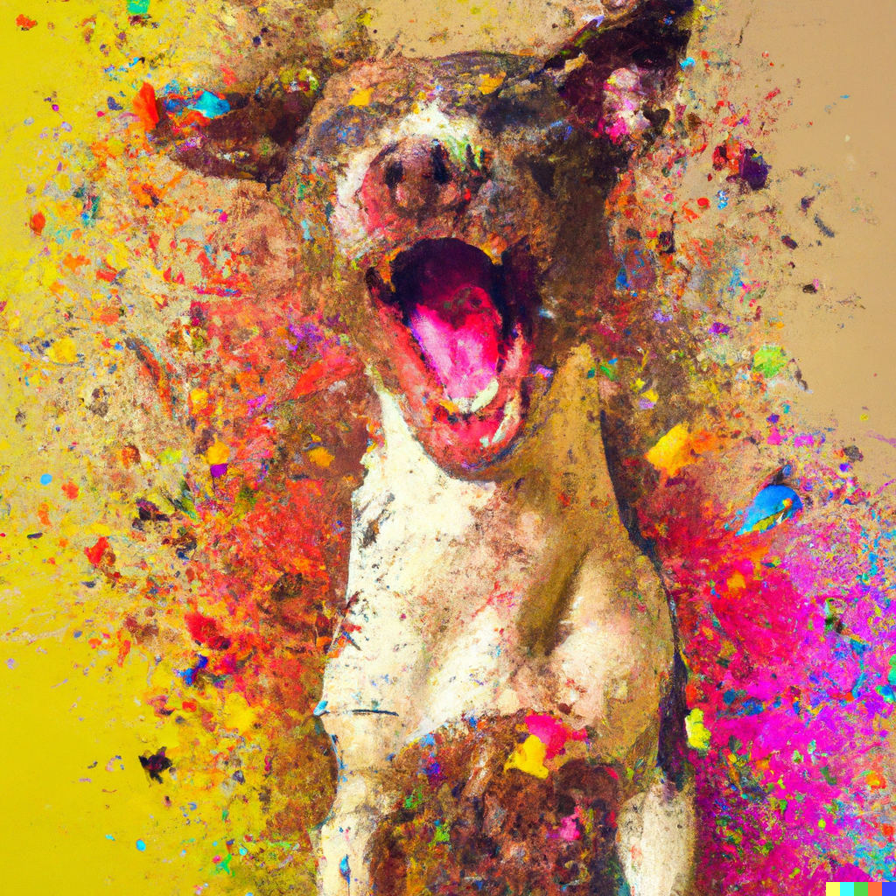
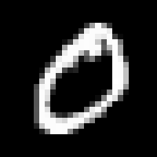

Image Representation
Is a matrix or grid of intensity values
integers [0, 255] or float points [0,1]
Each element in the matrix is a pixel
Can have 1 greyscale channel or multiple colour channels: RGB

Slide 10
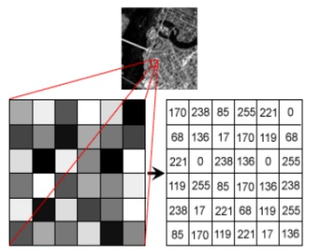
Image Representation
Is a matrix or grid of intensity values
integers [0, 255] or float points [0,1]
Each element in the matrix is a pixel
Can have 1 greyscale channel or multiple colour channels: RGB

Slide 11
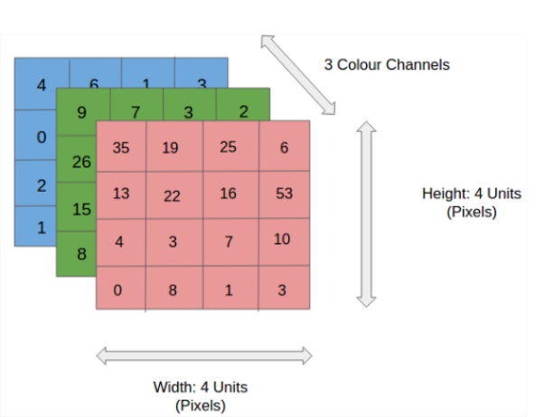
Image Representation
Is a matrix or grid of intensity values
integers [0, 255] or float points [0,1]
Each element in the matrix is a pixel
Can have 1 greyscale channel or multiple colour channels: RGB

Slide 12
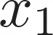

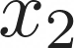
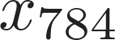
Correlated structures
...
...
...
...
Images are correlated spatially
Strong correlation between neighbouring pixels
Shifting an object will not alter its essence

Slide 13
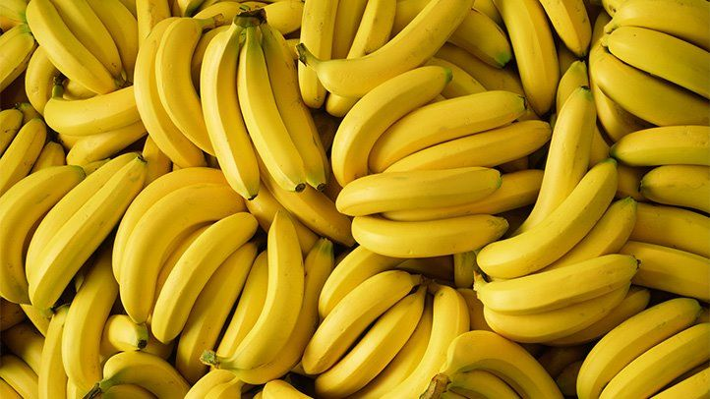
Correlated structures
...
...
...
...
Images are correlated spatially
Strong correlation between neighbouring pixels
Shifting an object will not alter its essence

Slide 14
Correlated structures
...
...
...
...
Images are correlated spatially
Strong correlation between neighbouring pixels
Shifting an object will not alter its essence

Slide 15
Correlated structures
...
...
...
...
Images are correlated spatially
Strong correlation between neighbouring pixels
Shifting an object will not alter its essence

Slide 16
Correlated structures
...
...
...
...
Images are correlated spatially
Strong correlation between neighbouring pixels
Shifting an object will not alter its essence

Slide 17
Correlated structures
...
...
...
...
Images are correlated spatially
Strong correlation between neighbouring pixels
Shifting an object will not alter its essence
Detect the features across an image and aggregate them
Form complete features higher up in the hierarchy

Slide 18
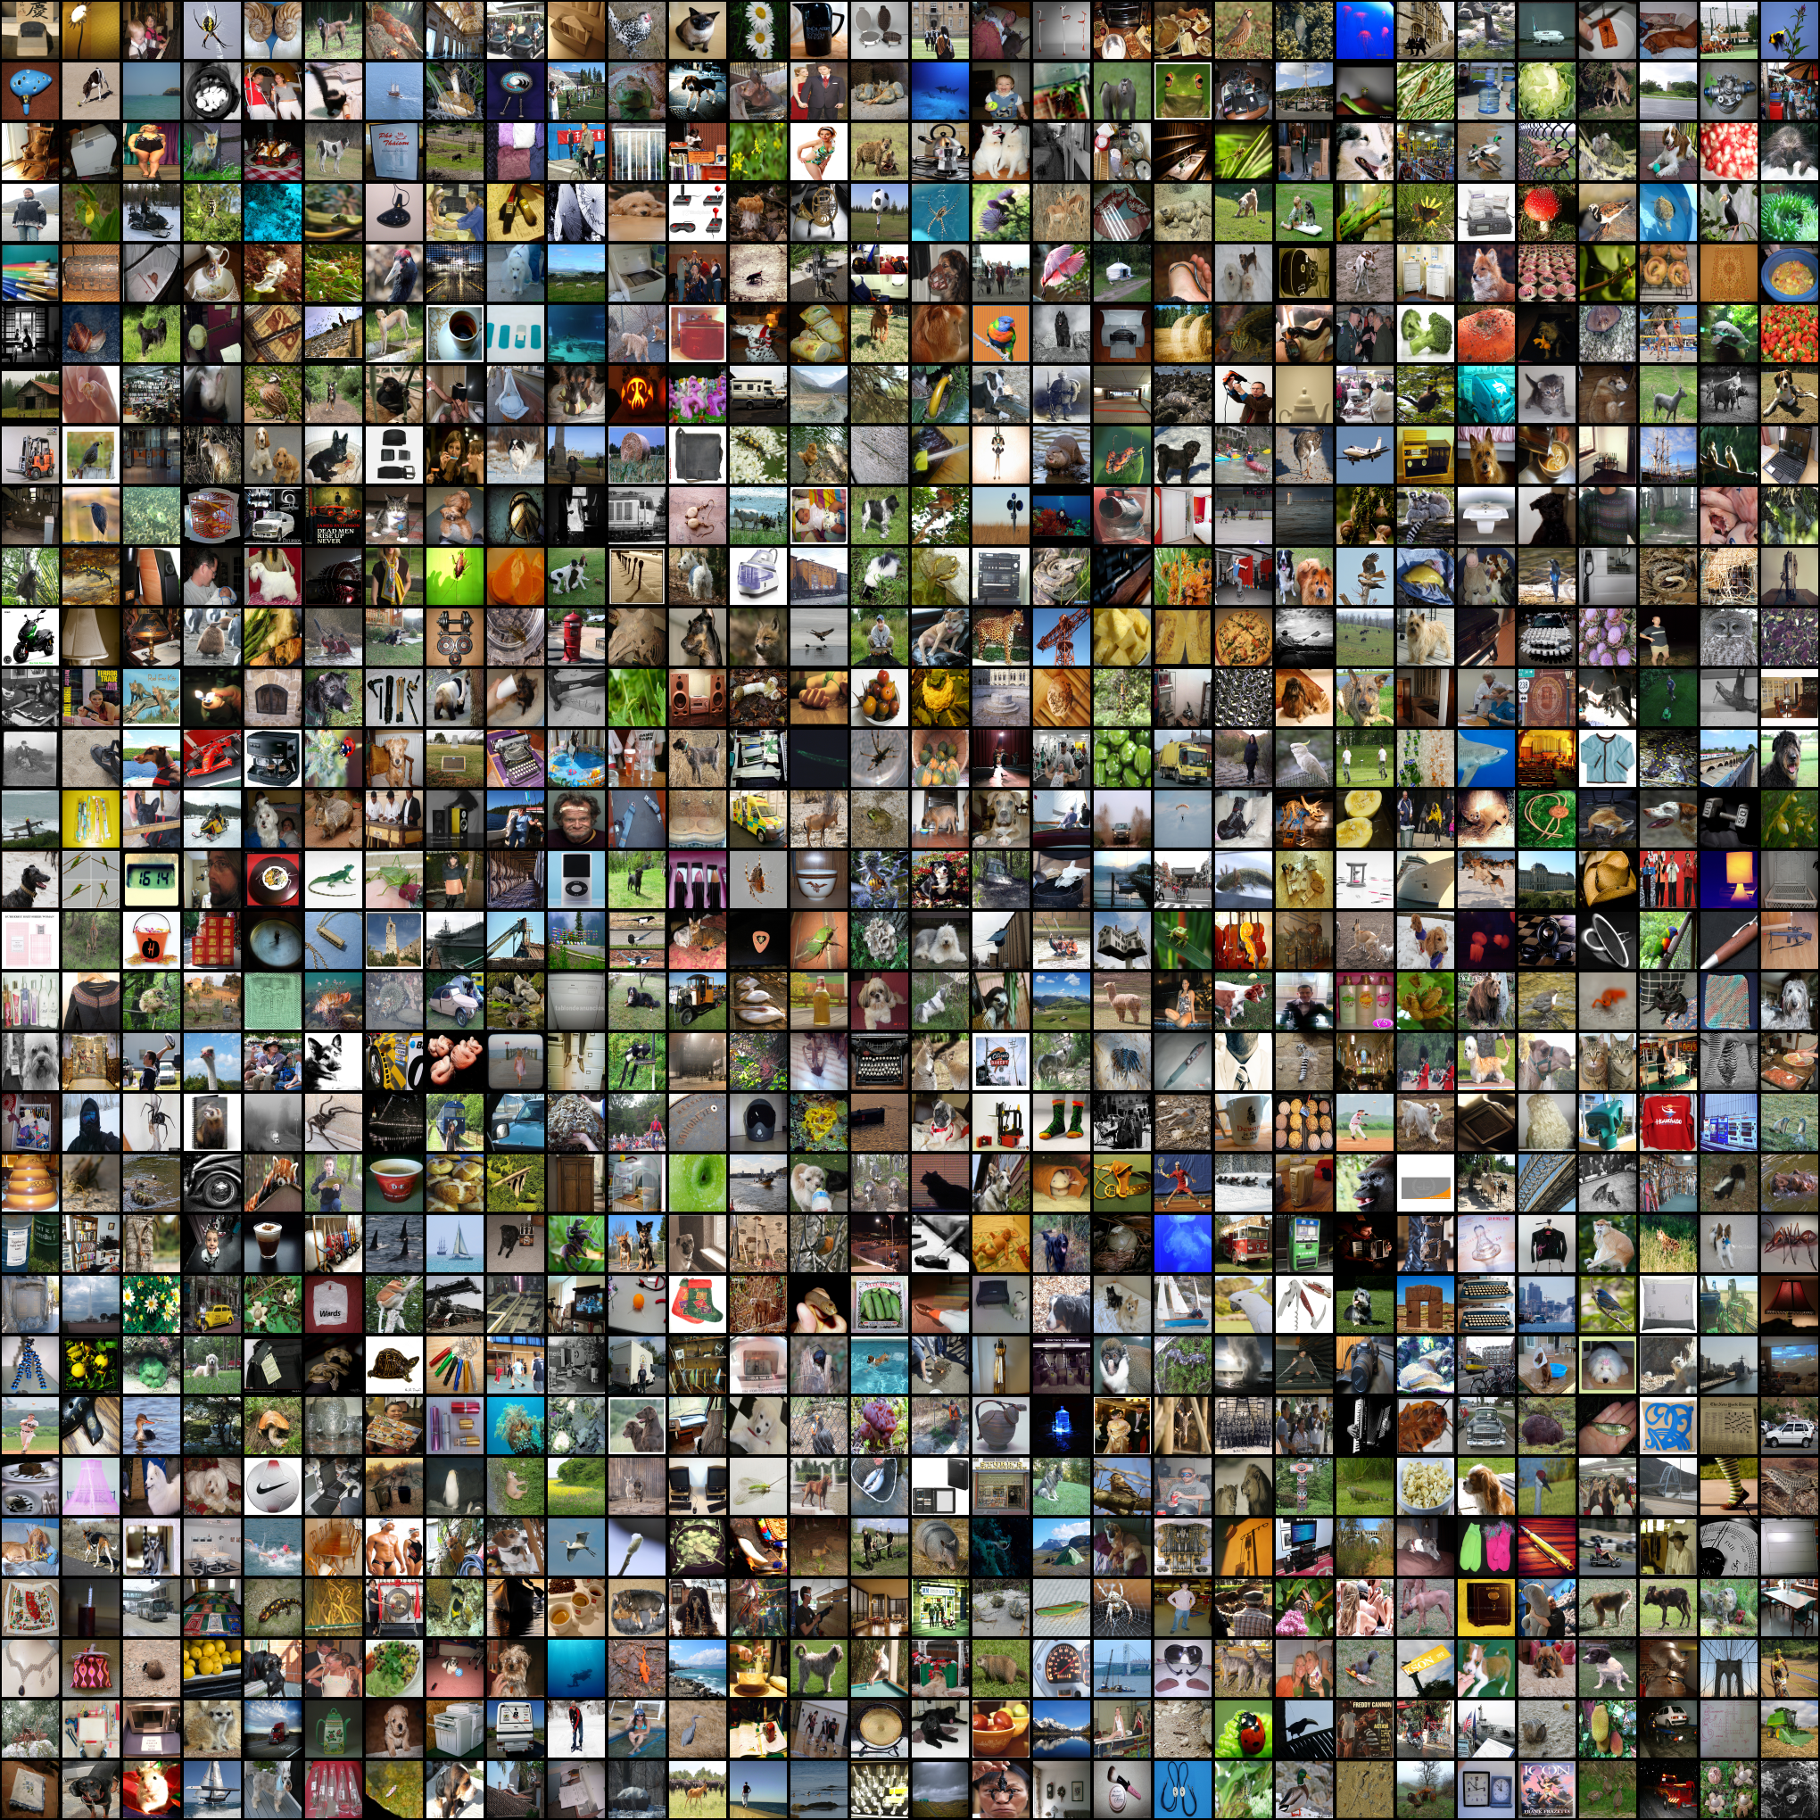

ImageNet Challenge
Computer Vision Benchmark 1.4M Images, 1000 classes
Image Classification Difficult until 2012

Slide 19
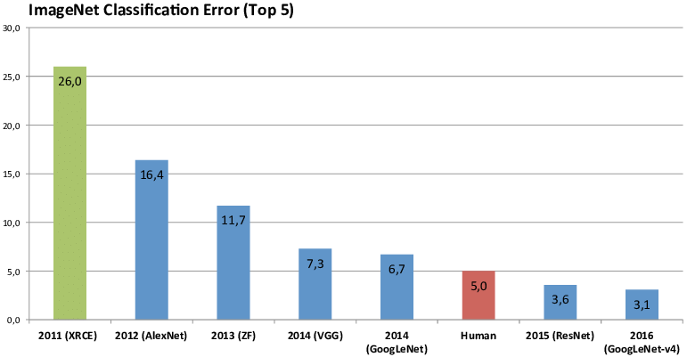
ImageNet Challenge
Computer Vision Benchmark 1.4M Images, 1000 classes
Image Classification Difficult until 2012

Slide 20
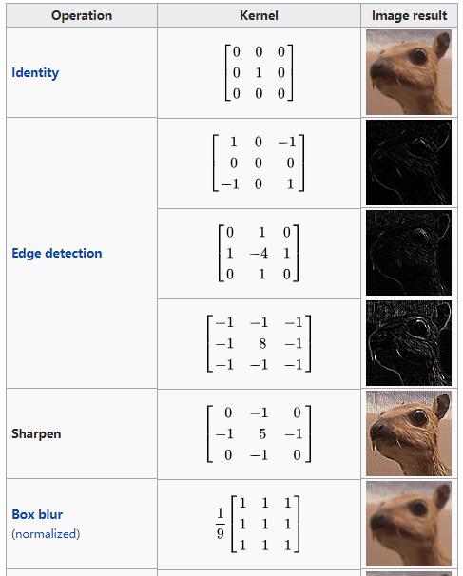
Convolutions
Kernel (filter): small matrix that we use to convolve an image
Convolution:
An operation that “blends” one function with another.

Slide 21

Convolutions
Kernel (filter): small matrix that we use to convolve an image
Convolution:
An operation that “blends” one function with another.
A filter applies a convolution operation on an image

Slide 22
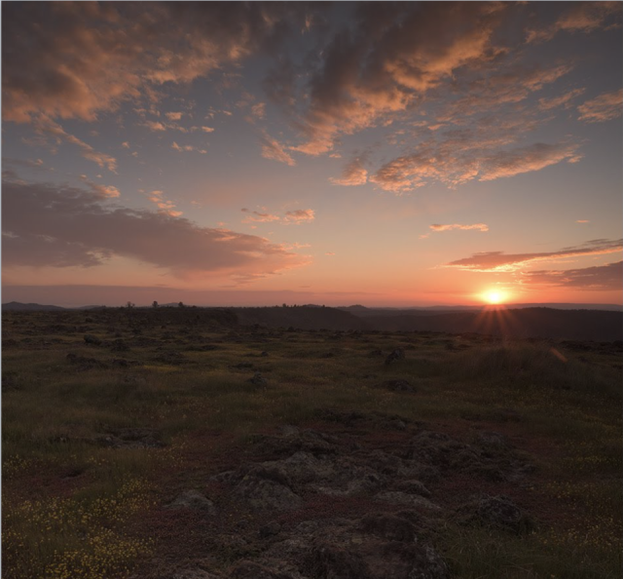

Convolutions
Kernel (filter): small matrix that we use to convolve an image
Convolution:
An operation that “blends” one function with another.
A filter applies a convolution operation on an image

Slide 23

Convolutions
Kernel (filter): small matrix that we use to convolve an image
Convolution:
An operation that “blends” one function with another.
A filter applies a convolution operation on an image

Slide 24
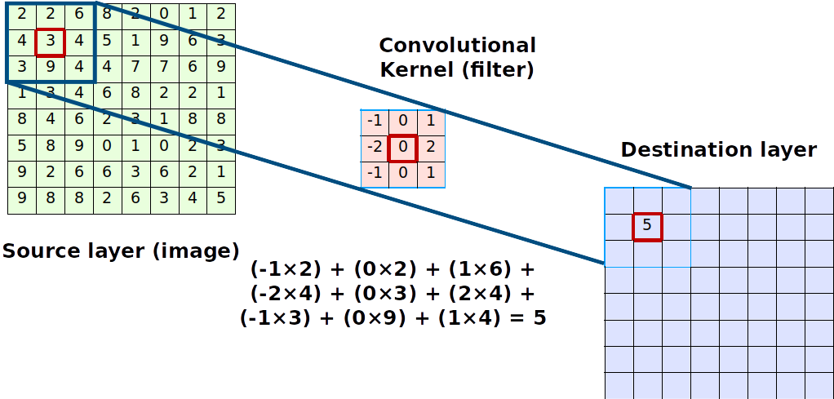
Convolutions Compute

Slide 25
Convolutions Compute
The kernel is shifted across the image and produces a point value
The step size in which it shifts is the stride
The output is always smaller, we use padding to preserve dimensions

Slide 26
Convolutions Compute
The kernel is shifted across the image and produces a point value
The step size in which it shifts is the stride
The output is always smaller, we use padding to preserve dimensions
The image shrinks according to
Output_size = inputSize -(KernelSize - 1)

Slide 27
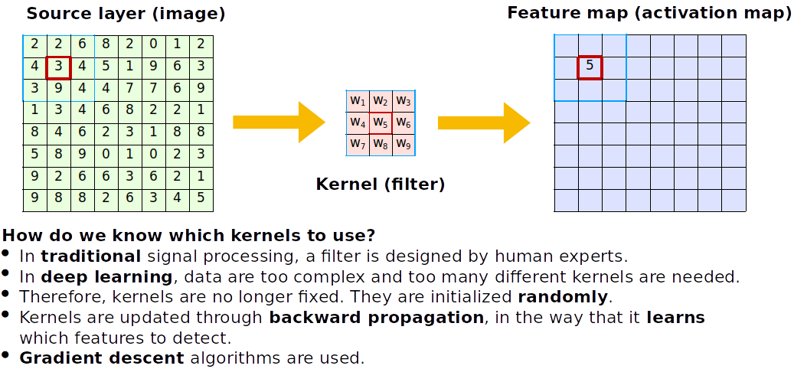
Convolutions

Slide 28
Convolutions

Slide 29
Convolutions
How do we know which kernels to use?
Kernels are learnt and initialized randomly
during training the CNN learns spatial features

Slide 30
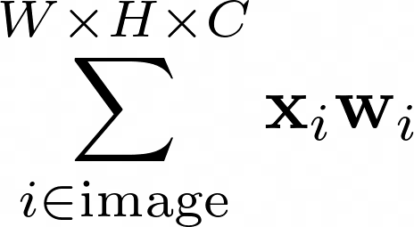
Convolutions
Fully connected
How do we know which kernels to use?
Kernels are learnt and initialized randomly
during training the CNN learns spatial features

Slide 31
Convolutions
Fully connected
How do we know which kernels to use?
Kernels are learnt and initialized randomly
during training the CNN learns spatial features

Slide 32
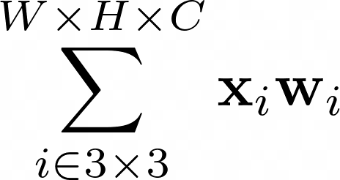
Convolutions
Fully connected
Locally connected
shared weights
How do we know which kernels to use?
Kernels are learnt and initialized randomly
during training the CNN learns spatial features

Slide 33
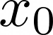
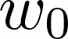
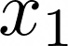
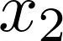
Anatomy of an Convolutional Neural Network
CNNs actually look a lot like normal Dense Neural Networks
Interpretation: Every node is a kernel

Slide 34
Anatomy of an Convolutional Neural Network
See the nodes as moving across the image!
We say these are shared weights
CNNs actually look a lot like normal Dense Neural Networks
Interpretation: Every node is a kernel

Slide 35
Anatomy of an Convolutional Neural Network
Fully connected
Locally connected
shared weights
See the nodes as moving across the image!
We say these are shared weights
CNNs actually look a lot like normal Dense Neural Networks
Interpretation: Every node is a kernel

Slide 36
Anatomy of an Convolutional Neural Network
Fully connected
Locally connected
shared weights
See the nodes as moving across the image!
We say these are shared weights
CNNs actually look a lot like normal Dense Neural Networks
Interpretation: Every node is a kernel

Slide 37

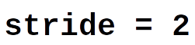
Pooling and dilated convolutions
We could discard information gradually by max pooling
Keep the strongest signal, works better than average pooling
Nowadays, we use a bigger stride for dimensionality reduction

Slide 38

Pooling and dilated convolutions
We could discard information gradually by max pooling
Keep the strongest signal, works better than average pooling
Nowadays, we use a bigger stride for dimensionality reduction
Dilated convolutions can be used if you expect your images to have information which are spatially far from each other

Slide 39
11/01/2023
CNN Cases
High Performance Machine Learning Group

Slide 40
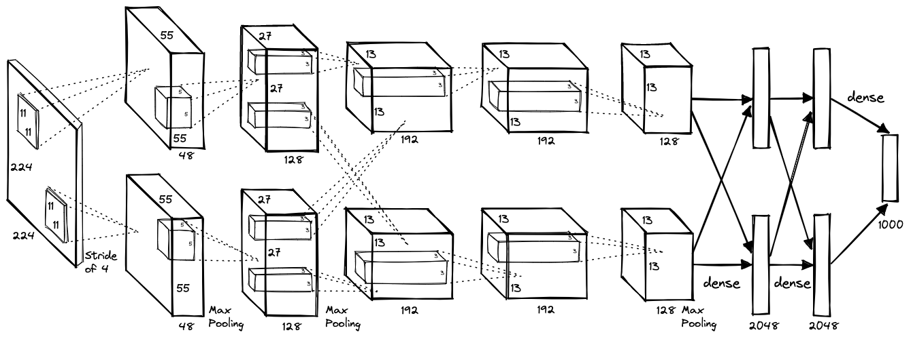
AlexNet (2012)

Slide 41
AlexNet (2012)
Images become smaller and number of filters increases as we go deeper
8 layers with dropout and ReLU activations trained for 6 days on 2 GPUs

Slide 42
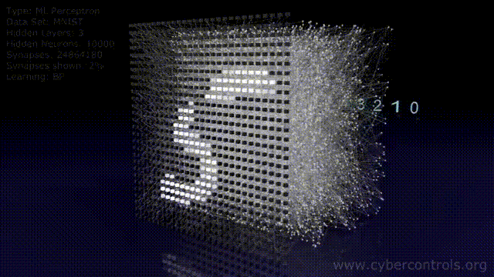

Slide 43
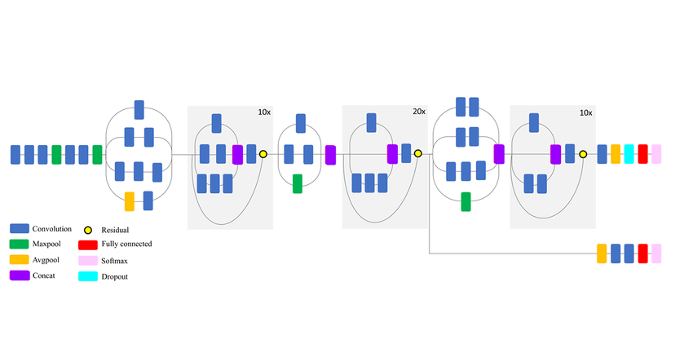
Transfer Learning

Slide 44
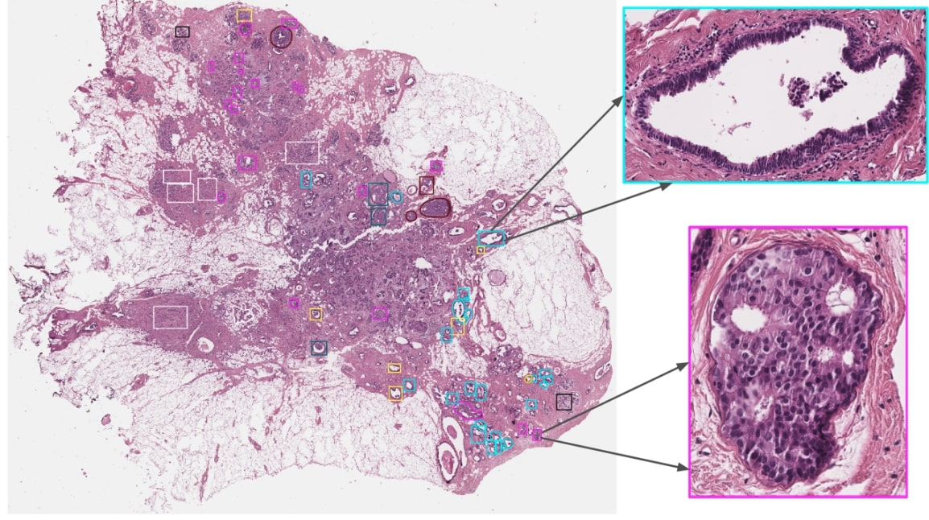
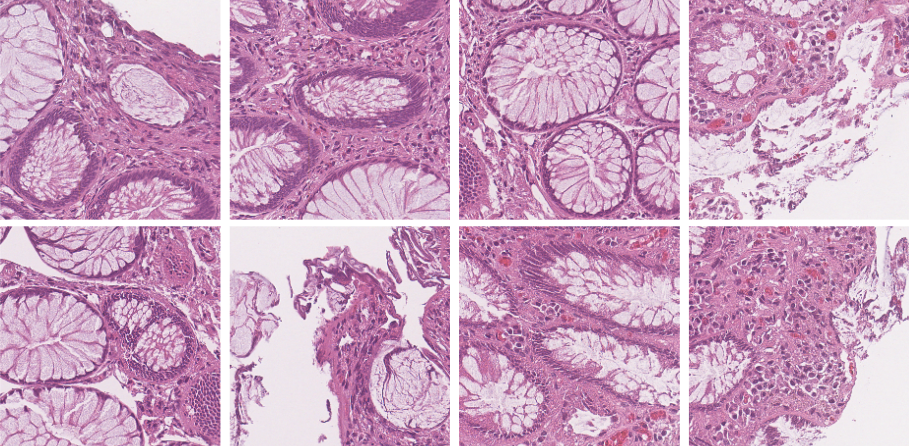
Transfer Learning

Slide 45
09/11/2022
Thank You
High Performance Machine Learning Group

Slide 46

VGG16 and ResNet (2014, 2015)
VGG16: construct large and deep models (120M params)
Vanishing gradient problem

Slide 47
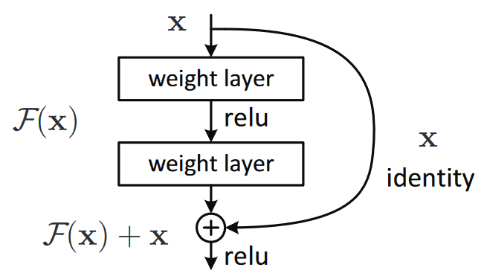
VGG16 and ResNet (2014, 2015)
VGG16: construct large and deep models (120M params)
Vanishing gradient problem

Slide 48
ResNet (2015)

Slide 49
ResNet (2015)
ResNets: construct large and deep models with skip connections, able to train up to 152 layers (!)
Higher abstraction and less nuisance from vanishing or exploding gradients

Slide 50
ResNet (2015)
ResNets: construct large and deep models with skip connections, able to train up to 152 layers (!)
Higher abstraction and less nuisance from vanishing or exploding gradients
Early layers learn features that get progressively more abstract, we can preserve and control the flow of information with skip connections

Slide 51
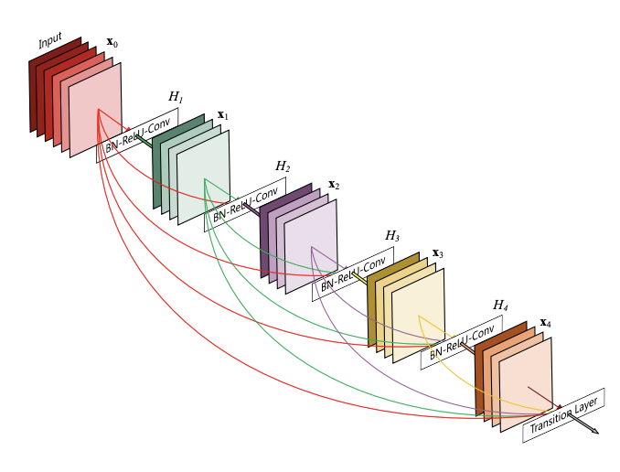
DenseNet (2016)
ResNets: construct large and deep models with skip connections, able to train up to 152 layers (!)
Higher abstraction and less nuisance from vanishing or exploding gradients
Early layers learn features that get progressively more abstract, we can preserve and control the flow of information with skip connections

Slide 52
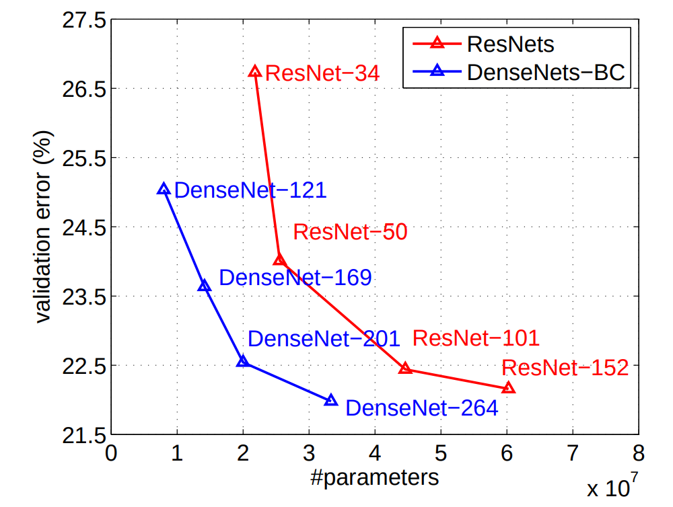
DenseNet (2016)
ResNets: construct large and deep models with skip connections, able to train up to 152 layers (!)
Higher abstraction and less nuisance from vanishing or exploding gradients
Early layers learn features that get progressively more abstract, we can preserve and control the flow of information with skip connections

